Slide 1
HIV, PEP & PrEP – The basics
Human Immunodeficiency Virus (HIV)
Post Exposure Prophylaxis (PEP)
Pre-Exposure Prophylaxis (PrEP)
Speaker: Mario G. Forte
(423) 226-1115 Voice & Text
mforte@cempa.org

Slide 2
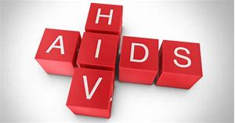
What is HIV?
HIV Stands for the Human Immunodeficiency Virus
This is the virus that, if left untreated, causes AIDS
AIDS is a disease in which there is a severe loss of the body’s cellular immunity, greatly lowering the body’s resistance to infections and malignancy.

Slide 6
Question in March 2019 from a lady at Women’s Awareness Day Event….
“Can you still get AIDS from a toilet seat?”

Slide 7
2019 Minority Health Fair –
Chattanooga, TN
165 People Surveyed.
We asked them to name the ways HIV was transmitted.
Roughly 1 in 4 (24%) did not accurately know how HIV is transmitted.
People Under 30 were less informed about HIV Transmission.
The 30-50 Age group were the most informed about HIV Transmission.
People Over 50, were also less informed about HIV Transmission.
(This group generally had old or outdated information that had not been updated)

Slide 8
HIV – Most Common Risk
Having anal or vaginal sex with someone who is living with HIV without using a condom or taking medicines to prevent (PrEP) or treat HIV.
For the HIV-negative partner, receptive anal sex (bottoming) is the highest-risk sexual behavior, but HIV can also be acquired from insertive anal sex (topping).
Either partner can get HIV through vaginal sex, though it is less risky for acquiring HIV than receptive anal sex.
Sharing needles or syringes, rinse water, or other equipment (works) used to prepare drugs for injection with someone who has HIV. HIV can live in a used needle up to 42 days depending on temperature and other factors.
From mother to child during pregnancy, birth, or breastfeeding.
By being stuck with an HIV-contaminated needle or other sharp object. This is a risk mainly for health care workers.
Oral sex—putting the mouth on the penis (fellatio), vagina (cunnilingus), or anus (rimming). In general, there’s little to no risk of getting HIV from oral sex. But transmission of HIV, though extremely rare, is theoretically possible if an HIV-positive man ejaculates in his partner’s mouth during oral sex. An STI’s in or around the mouth may also increase risk.
Someone with a history of STI’s may also be at high risk for contracting HIV.

Slide 9
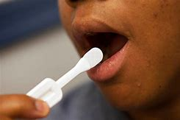
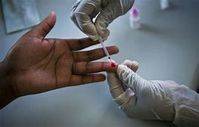
HIV – Knowing your status
Everyone has an HIV status (+ or -)
(However most people don’t know their status)
People learn their status by taking an HIV Test
The most common transmission of HIV is due to people not knowing their HIV status.

Slide 10
HIV + (Positive), A person living with the HIV Virus
Detectable
Detectable means that a person is living with the HIV virus and the virus is “detectable” during certain testing.
Undetectable
Undetectable means that the person has been taking medicine so that the virus is suppressed and, while that person will always remain HIV + positive, the virus is “undetectable” during certain testing.
U=U
Undetectable Equals Untransmittable.
A person that has achieved an undetectable HIV status, cannot transmit the virus sexually to their partner.
www.nih.gov

Slide 11
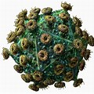
HIV – What are the odds?
What are the odds of transmission from a person that
is living with HIV and has a “detectable” viral load?
During the first few weeks following acquisition of HIV, viral loads (amount of HIV Virus) in the body are at their maximum levels and HIV is more commonly transmitted during this period.

Slide 12
Transmission odds from a person who is HIV positive with a detectable viral load
Poz Magazine
November 2016
Giving Oral Sex:
1 in 2,500
(0.04%)
Anal Sex
(Negative Bottom)
Ejaculates Inside
1 in 70
(1.43%)
Sharing a Needle
1 in 149
(0.67%)
Anal Sex
(Circumcised Negative Top)
1 in 909
(0.11%)
Vaginal Penetration
1 in 1,250
(0.08%)
Anal Sex
(Negative Bottom)
Ejaculates Outside
1 in 154
(0.65%)
Lower
Risk
HIV
Anal Sex
(Uncircumcised Negative Top)
1 in 161
(0.62%)
Medium
Risk
Highest Risk

Slide 13
Giving Oral Sex:
Occupational Needle Stick:
1 in 2,500
(0.04%)
Vaginal Penetration
1 in 1,250
(0.08%)
Number of TIMES
1
Lower
Risk
Anal Sex
(Circumcised Negative Top)
1 in 909
(0.11%)
Medium
Risk
Anal Sex
(Uncircumcised Negative Top)
1 in 161
(0.62%)
Anal Sex
(Negative Bottom)
Ejaculates Outside
1 in 154
(0.65%)
Sharing a Needle
1 in 149
(0.67%)
Highest Risk
Many
Anal Sex
(Negative Bottom)
Ejaculates Inside
1 in 70
(1.43%)
HIV Acquisition

Slide 14
What is PEP?
PEP Stands for the Post Exposure Prophylaxis
Medicine that is available to anyone that is HIV – Negative
that has had an IMMEDIATE* exposure to HIV.
*Exposure within the past 72 Hours

Slide 15
HIV – Immediate Exposure
Exposure to HIV is a Medical Emergency.
Medicines are available that can prevent you from becoming HIV+
There is a 72 Hour maximum window from time of exposure from when you MUST start the 28 days of the prescribed medicine.
There is copay assistance available that might pay for the total cost of the (approx. $4,000) medicine.
This protocol is called PEP
(Post Exposure Prophylaxis)
72 Hours

Slide 16
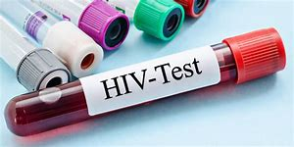
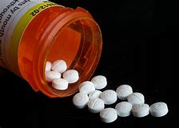
PEP – What is the Protocol?
Go to the ER (Emergency Room), Urgent Care or Agency that treats for PEP immediately.
Inform them that you’ve had an exposure to HIV and are requesting PEP
They will test you for HIV and then if you are negative, prescribe the appropriate medicine.
Take the PEP Prescription to the Pharmacy
Start taking the medicine immediately, and continue the daily regimen for 28 days.
NOTE:
PEP does not guarantee a person will remain HIV negative, however results are more favorable the closer medicine is taken from the time of exposure.
PEP will not be effective after 72 hours from exposure.
Drug Copay Assistance may be required to pay for the medicine. Ask the Pharmacist for this help.

Slide 17
PEP – The Barriers

Slide 18
PEP – Treatment options. Copay Assistance.

Slide 19
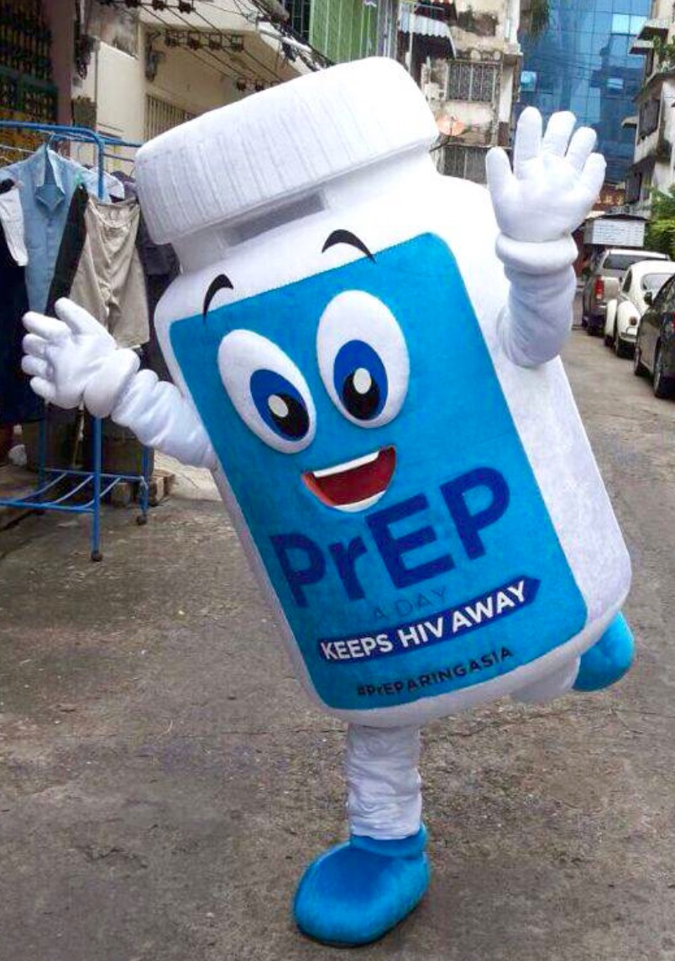
PEP – Next Step
Following completion of the 28 day regimen of daily medicine, patient should be scheduled for a follow up and another HIV Test
The clinician will test again for HIV.
If Negative for HIV, patient should be scheduled for another follow up test in 90 days.
Also, if patient is a candidate for PrEP, they should be referred for treatment.
If Positive for HIV, patient should be referred for treatment.

Slide 20
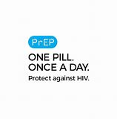
What is PrEP?
PrEP Stands for the Pre Exposure Prophylaxis
Medicine that is available to anyone that is HIV – Negative
that might be at Risk for contracting HIV.

Slide 21
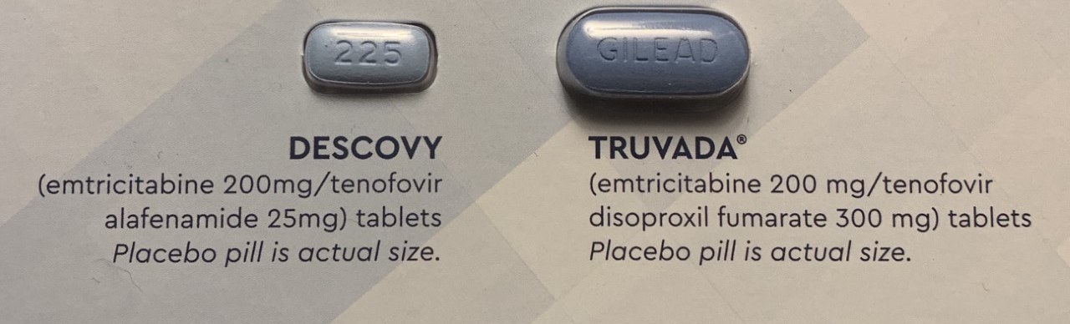
PrEP – The Current FDA approved Medicines
Truvada will be available in
Generic form in October 2020.

Slide 22
PrEP – Future Medicines

Slide 23
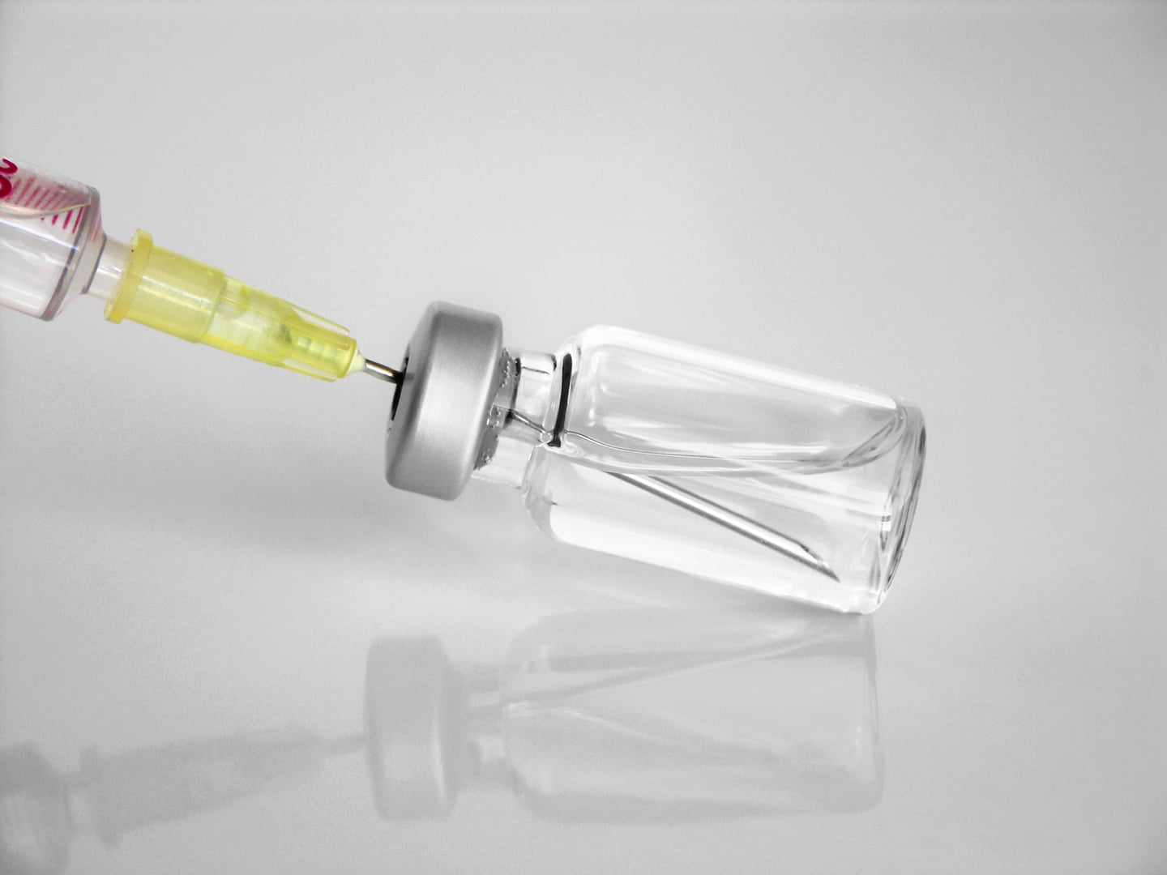
PrEP – Future Medicines
Injectable PrEP
Taken every 2 months, the long-acting injectable drug cabotegravir (CAB-LA) may open the door for a new biomedical HIV prevention option aimed at those who would prefer a shot six times a year over taking a daily pill.

Slide 24
PrEP – Who could benefit?
People who inject drugs / share needles
Men who have sex with other men
Transgender Women who have sex with men
Someone with a history of a Sexually Transmitted Infection
Sex workers
People who have inconsistent or no Condom use
People who have multiple sex partners
People who have sex partners that do not know their HIV status
ANYONE that may have difficulty negotiating condom use
or who doesn’t trust their partners.
Status different Couples, where one partner is HIV+ and the other –
Or ANYONE who is sexually active or injects drugs that has ANXIETY about contracting HIV.

Slide 25
PrEP – What is the Protocol?
HIV and other lab testing is required every 90 days at a clinic or doctors office.
If a person tests HIV – Negative, then a prescription is written for the next 90 days.
The medicine is taken daily and is continued for as long as the person remains at risk for contracting HIV.
NOTE:
If someone has anxiety about contracting HIV or consider themselves to be at risk for HIV, then PrEP might be right for them.
PrEP does not work for other Sexually Transmitted Infections.
PrEP is extremely effective (Over 99%) at preventing HIV.
It takes about 7 Days of Medicine for Men and 20 Days for Women to build up maximum levels of protection against HIV. Then daily dosing to maintain these maximum levels.

Slide 26
EDUCATION AND OUTREACH STRATEGY
Many people don’t think or believe they are at risk for contracting HIV and therefore
may not feel they are candidates for PrEP.
Use PEP as an education TOOL to introduce PrEP
An effective method for educational outreach to women
Talk about PEP, outline it’s basic use and protocol
Inform that PEP is there if anyone has a potential exposure to HIV.
(Victims of Sexual Assault, Condom break, etc.)
Then discuss the potential for long term protection – PrEP.

Slide 27
Useful Links and Other Information
Prep info: www.cdc.gov/hiv/basics/prep.html
Prescribers Guide: http://start.truvada.com/hcp/prescribing-truvadaprep#
Gilead Co-Pay Coupon Card: www.gileadcopay.com
Un-insured PrEP Assistance: www.gileadadvancingaccess.com
https://www.copays.org/diseases/hiv-aids-and-prevention
Healthcare Insurance: www.healthcare.gov or www.HealthSherpa.com
Smartphone App: “Care4Today” (Reminder to take pills)
GetPrEPTN.com (Tennessee Specific. Includes Navigator Information)
PrEPlocator.org (USA Nationwide)

Slide 28
Presentation prepared by Mario G. Forte, PrEP / PEP Navigator
(423) 226-1115 Voice/Text Mforte@Cempa.org

