Slide 1
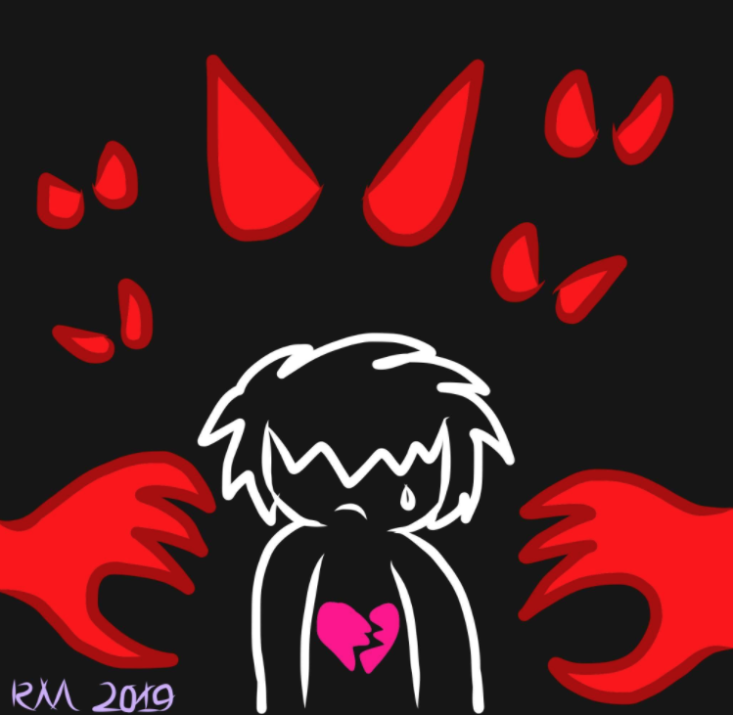
ART, AUTISM AND PTSD
YADIRA V. CALDERON, M.A.
AND RAINBOW MOSHO
- AUG. 28, 2020
TCSW CONFERENCE

Slide 2
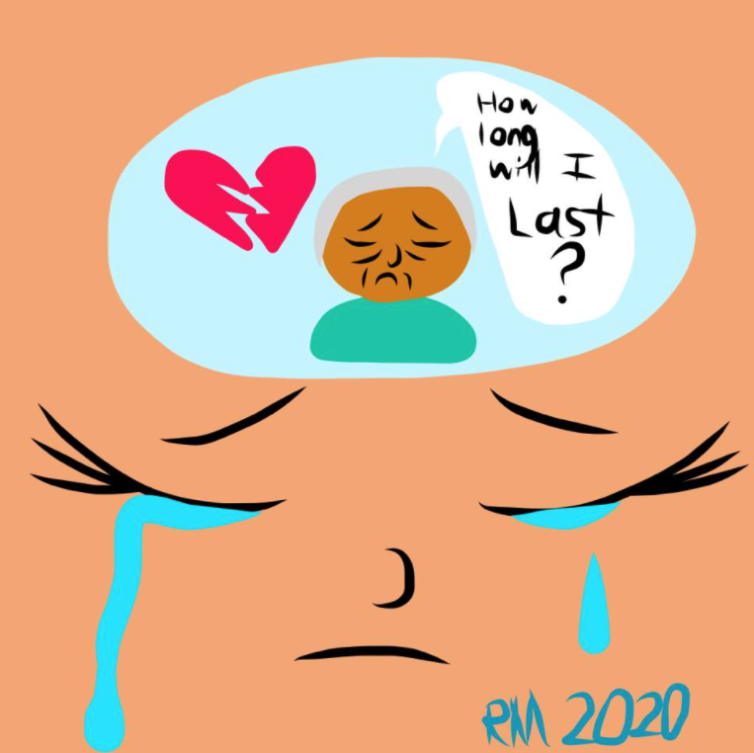
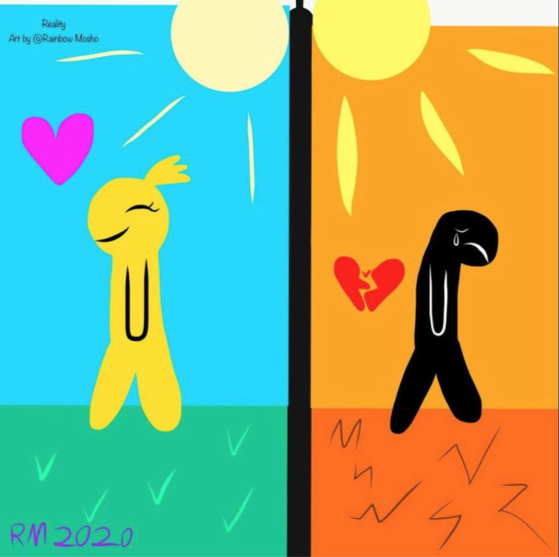
WHO DREW THIS? // HOW OLD IS THE ARTIST?
WHAT DO YOU FEEL/THINK?

Slide 3
Bullying is a reality and PTSD is one of its consequences.
Lack of social skills, diverse family realities, pressure of social media - all influence negatively the
interaction in middle school.
Research confirms, a student with a diagnosis may face greater challenges and become an easy target.
Join Yadira as she shares her parental approach through Art - her goal is to empower children with disabilities to survive PTSD and bullying at school.
-- Virtual - Friday August 28, 2020
Session VI - 3:40 pm to 4:55 pm

Slide 4
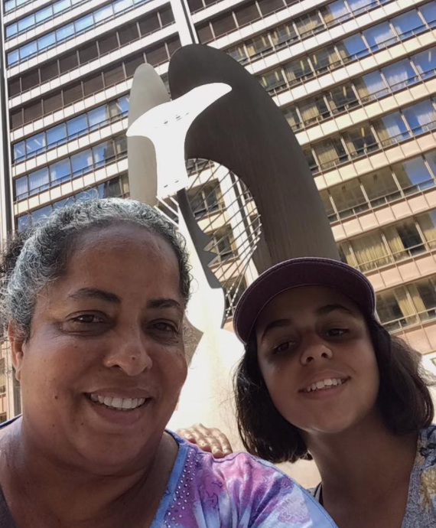
Who are We?
Yadira V. Calderon has been eating, breathing, sleeping, challenging and accepting autism since 2011. She is a dedicated warrior, author in the making and advocate.
She holds a M.A. International Relations and Diplomacy, speaks three languages and has lived in six countries, having travelled to another twenty-seven. Her friends know she is determined, persistent, positive, creative, open-minded and realistic. She believes these attributes and newly discovered ones prepared her to become the mother of Thomais.

Slide 5
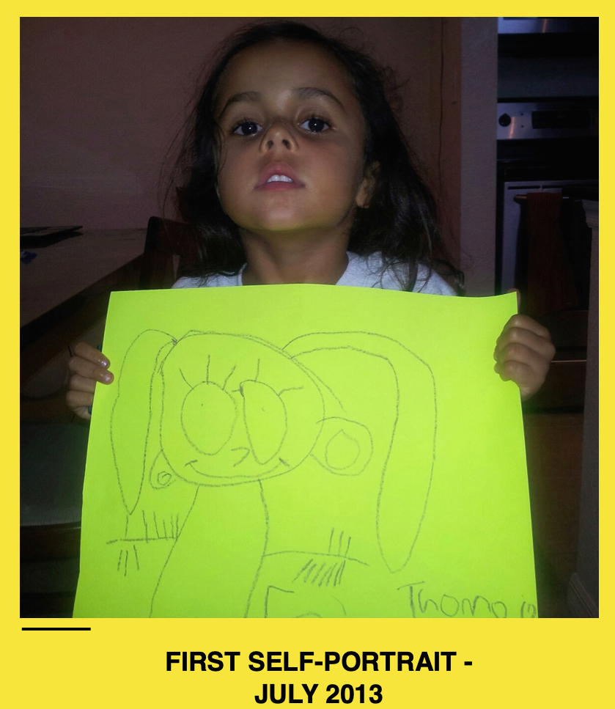
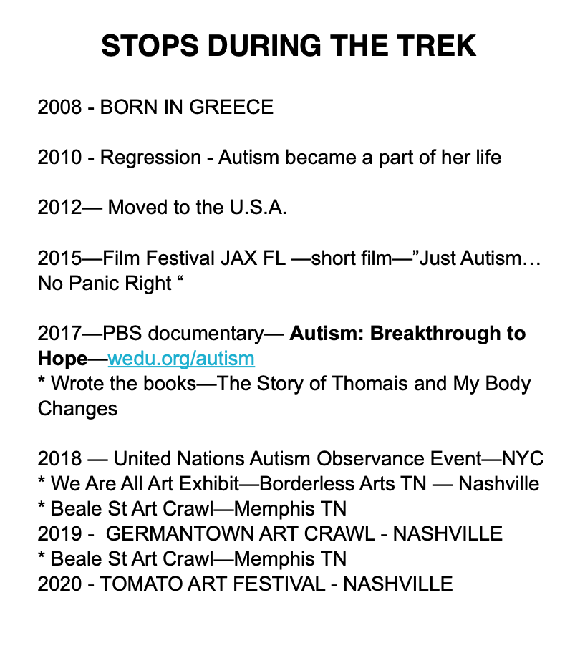

Slide 6
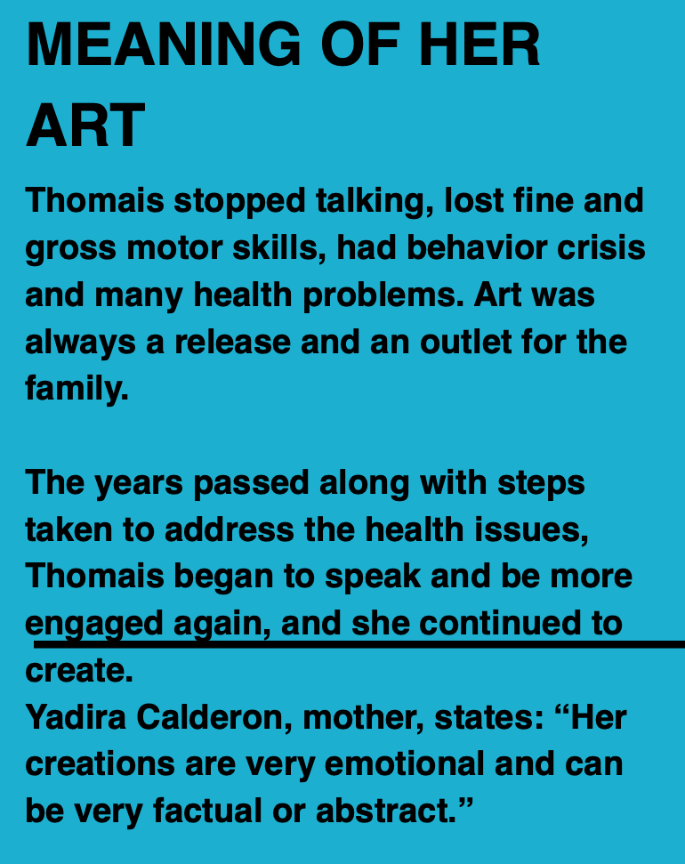
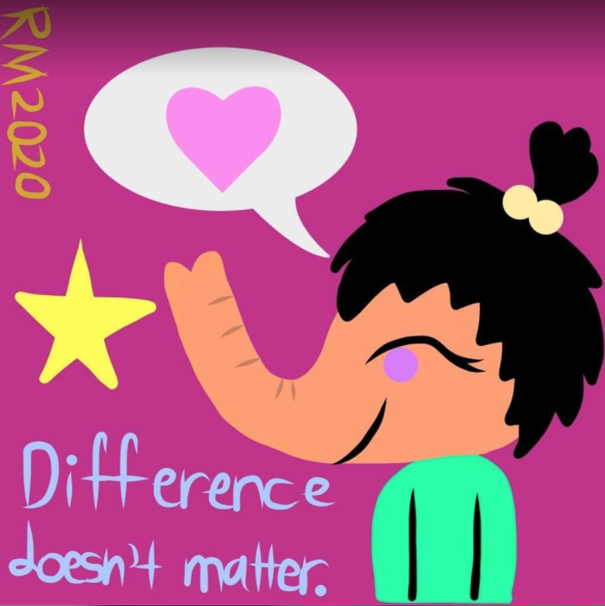

Slide 7
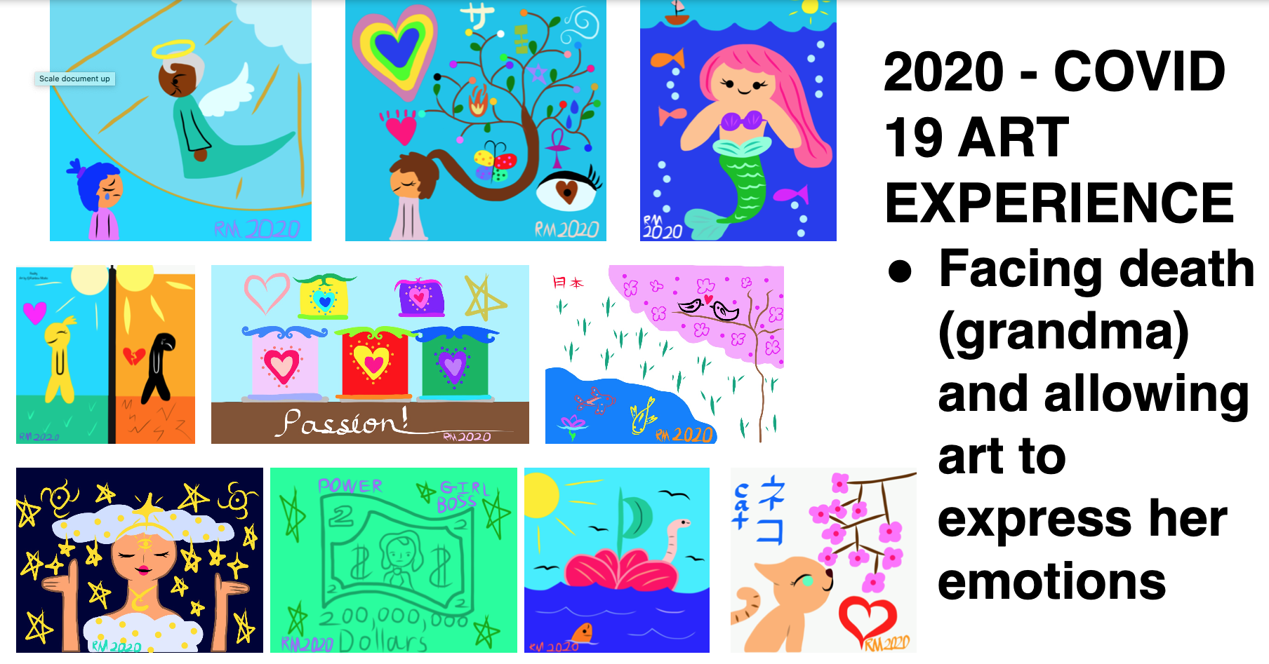

Slide 8
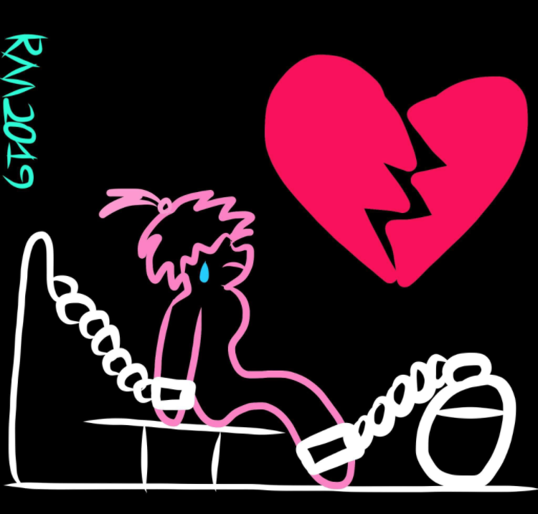
SOURCES OF PTSD
Experiences lived -- that result in PTSD
- Family life - death of a loved one, single mom - stress, family separation
- School - summer school - placed in a bathroom, teacher screaming, time outs not providing support to the learning process
- Community - isolation, rejection, being screamed at
Characteristics of the diagnosis - Autism Spectrum Disorder - that limit the acquisition of tools to better handle a variety of situations (that could result in PTSD)
- auditory processing
- sensory issues
- limited understanding of social cues
- language
- lack of advocacy skills

Slide 9
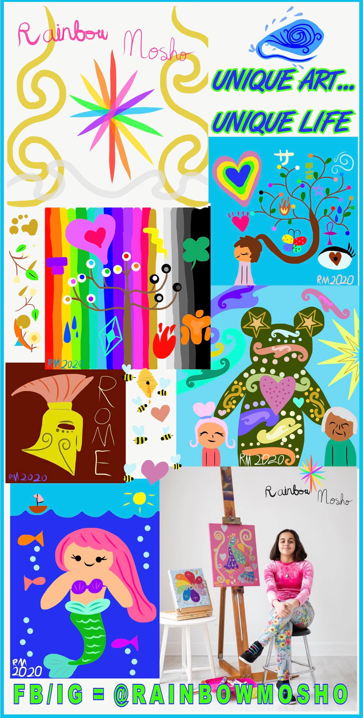
WHY
ART
AS THERAPY?
Art therapy may offer an alternative and suitable treatment, because the nonverbal and experiential character of art therapy appears to be an appropriate approach to the often wordless and visual nature of traumatic memories.
https://www.researchgate.net/publication/327055795_Trauma-Focused_Art_Therapy_in_the_Treatment_of_Posttraumatic_Stress_Disorder_A_Pilot_Study
* Thomais can now speak -- she can now verbalize a variety of emotions
* When she could not speak - art, creativity allowed for the expression of anger, sadness, frustration, joy

Slide 10
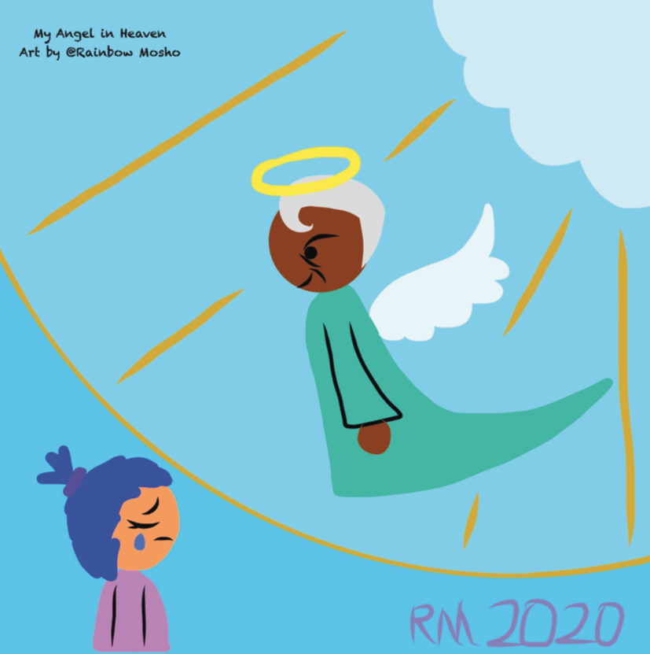
WHY ART AS THERAPY?
Art Therapy Research
Key Creative Forces clinical research findings indicate:
Art therapy helps in recovering from traumatic experiences, reducing flashbacks and nightmares.
Artworks created in art therapy can act as agents for change to improve frustration tolerance and stabilize emotions.
Art therapy helps in coping with difficult experiences and feelings such as grief, loss, avoidance, survivor’s guilt, and shame related to wartime.
Art therapy may foster connectivity in the brain to help support healthier brain function.
https://www.arts.gov/national-initiatives/creative-forces/research/art-therapy-research#:~:text=%20Key%20Creative%20Forces%20clinical%20research%20findings%20indicate%3A,feelings%20such%20as%20grief%2C%20loss%2C%20avoidance%2C...%20More%20

Slide 11
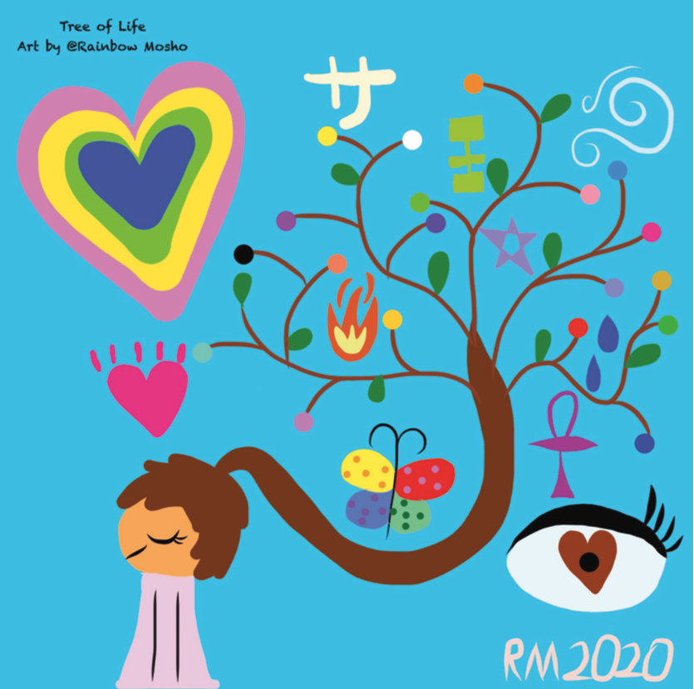
WHY ART AS THERAPY?
Art therapy can promote neurological and cognitive functioning:
Art therapy improves concentration and memory
Art therapy may foster connectivity in the brain to help support healthier brain function.
• Art therapy can enhance enjoyment and promote relaxation.
Art therapy fosters the ability to relate to others.
• Art therapy helps in overcoming resistance to treatment due to societal stigma of pursuing treatment for PTSD.
• Art therapy is helpful in reducing isolation and connecting with others who experience similar challenges.
https://www.arts.gov/sites/default/files/Creative-Forces-Summary-of-Art-Therapy-Research-Findings-2.26.2019.pdf

Slide 15
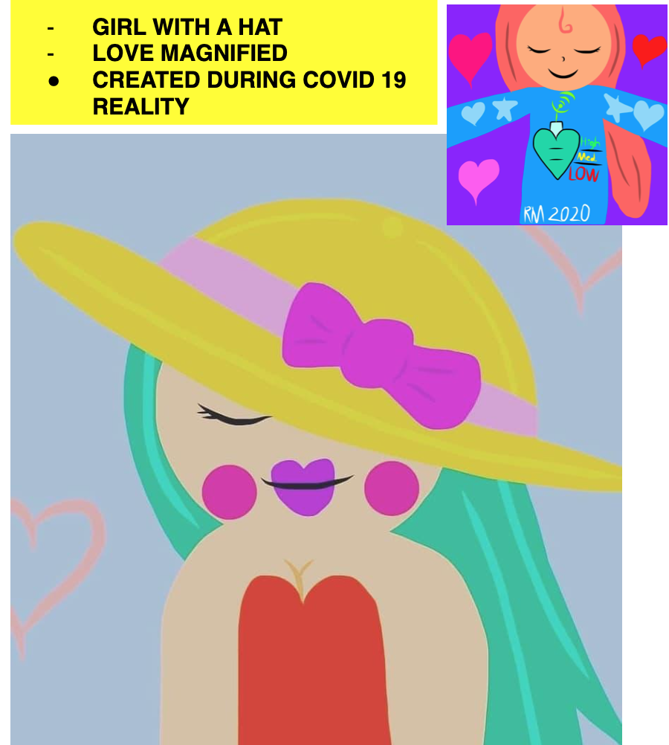
OUR REQUESTS
* WE urge researchers/investigators/social workers to engage with the community diagnosed as developmentally disabled and their families -- they have PTSD
- verbal/non-verbal - many have been exposed to experiences similar to those my daughter can now remember.
* WE urge teachers/principals working with children with a variety of diagnosis to seek support from the district to bring in training to all interacting on a daily basis with this population.
* Community - open your doors, communicate with us, respect the differences

Slide 16
THANK YOU!
www.autismhappykingdom.com
FB/IG =
RAINBOW MOSHO
rainbowmosho@autismhappykingdom.com

